Slide 1


20
25
SMALL RETAIL INVENTORY SYSTEM PL/SQL CAPSTONE
Names: Cedrick Habimana
ID: 27443
Course: INSY 8311 - Database Development with PL/SQL
Instructor: Eric Maniraguha
Academic Year: 2024-2025
01

Slide 2


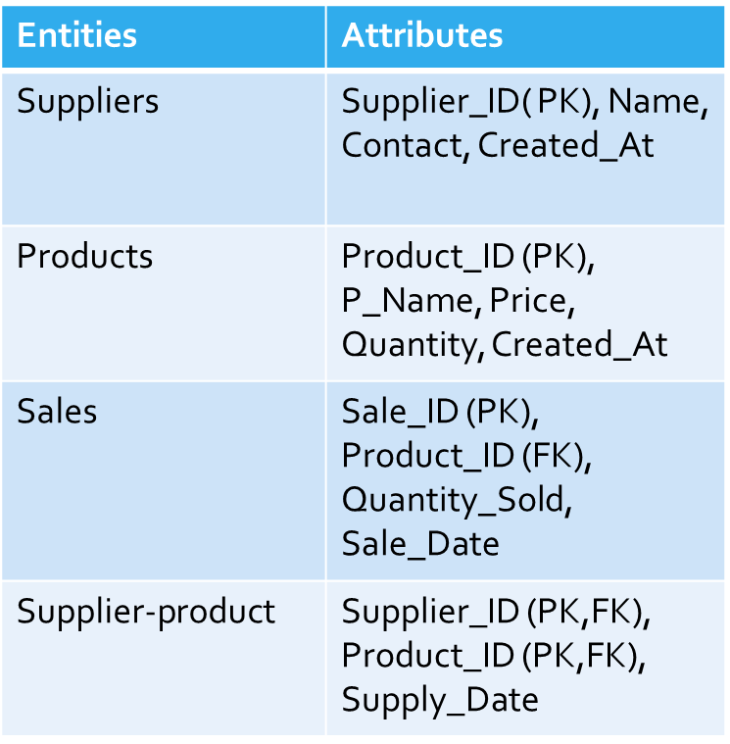

Introduction
20
25
• Purpose: Address inventory challenges in small retail businesses
•Technology Used: Oracle 21c, SQL Developer
•Project Focus: Stock tracking, supplier coordination, audit & automation
02

Slide 3
20
25
• Manual stock tracking causes overstocking or stockouts
• Lack of alert system for low inventory
• No audit trail for accountability
• Need for automation and secure data operations
Problem Definition
03

Slide 4
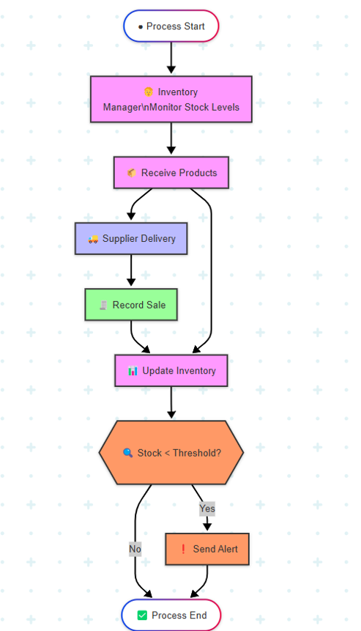
Methodology& Approach+ Swimlane workflow
Phase I: Problem identification
Phase II: Process modeling (Mermaid + BPMN)
Phase III: ERD and normalization
Phase IV–V: DB creation, tables, sample data
Phase VI–VII: PL/SQL logic, packages, triggers, auditing
Swimlane Diagram:
shows the inventory management process, where a manager monitors stock levels, records sales, and receives alerts when stock falls below a threshold.
20
25
04

Slide 5
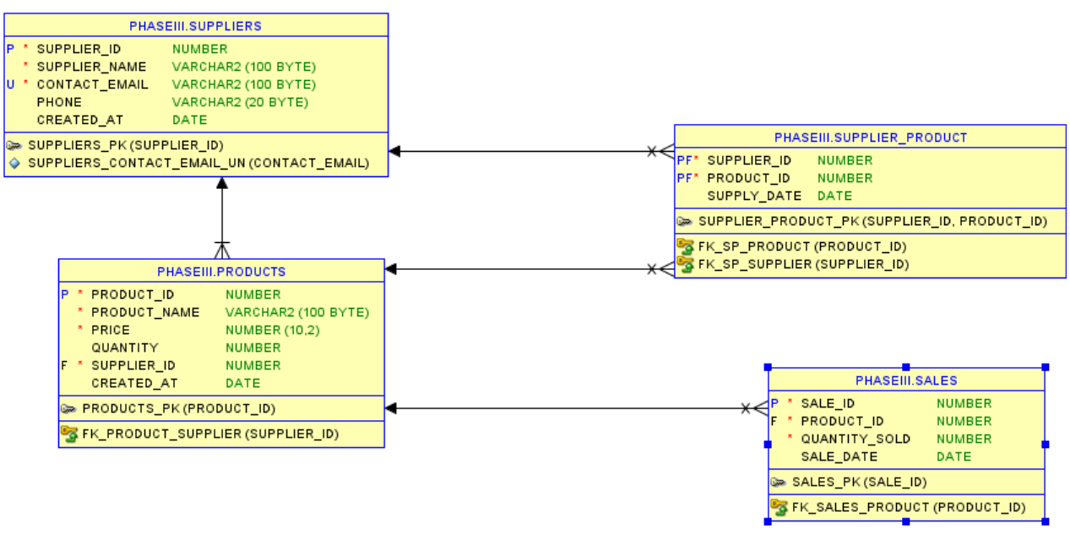
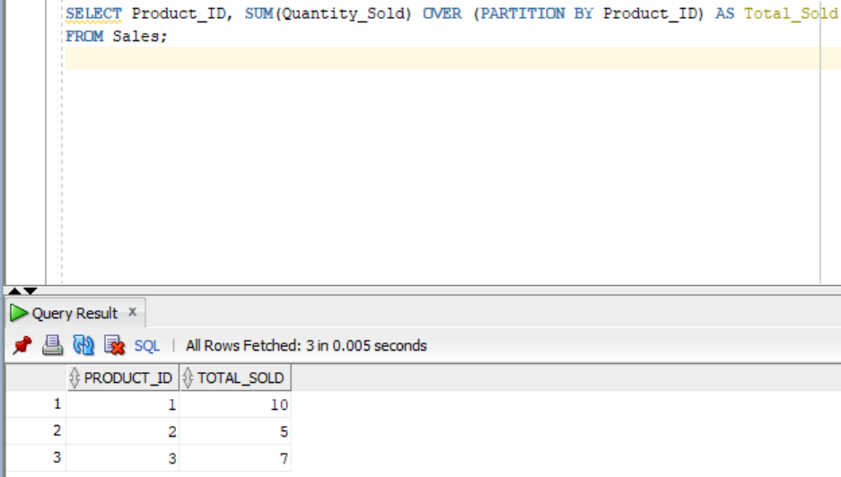
20
25
ERD-Diagram
Window Functions
Depicts the database structure for a supplier-product-sales system, with tables for suppliers, products, their relationships, and sales transactions
This query calculates the total quantity sold for each product by using a window function to sum all quantities within each product partition. It returns each product ID along with the cumulative total of quantities sold for that specific product across all sales records.
05

Slide 6
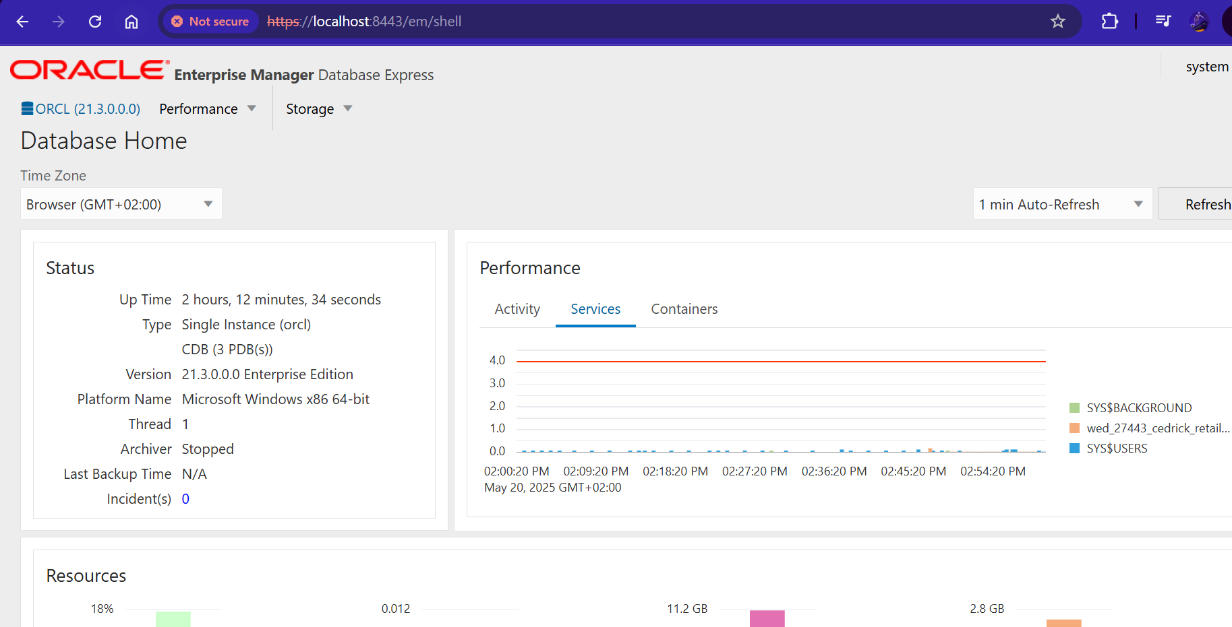
06
20
25
Oracle Enterprise Manager

Slide 7
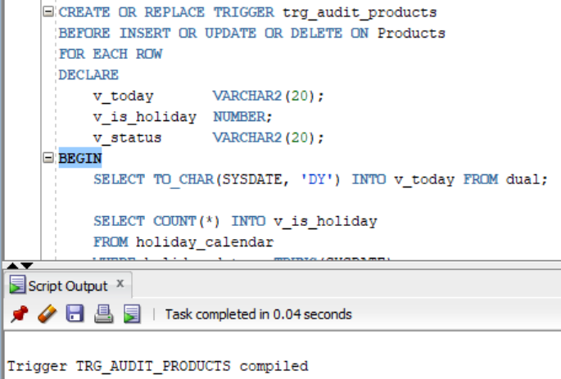
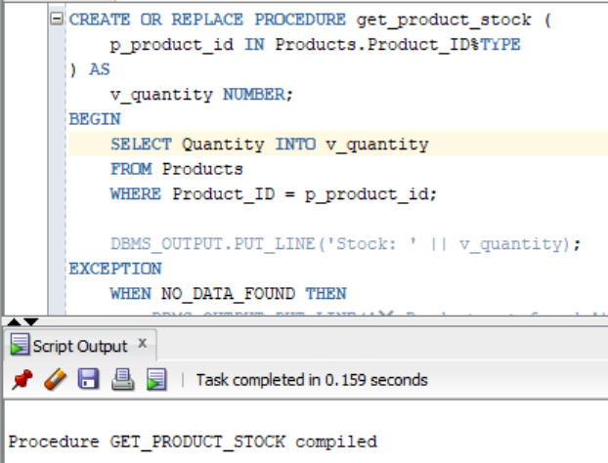
20
25
PL/SQL Procedures
PL/SQL Triggers
This Oracle stored procedure takes a product ID as input, retrieves the corresponding quantity from the Products table, and outputs it with a "Stock: " label using DBMS_OUTPUT. It includes complete exception handling that displays "Product not found" if no matching product exists, or "Unexpected error" with the SQL error message for any other exceptions.
This Oracle trigger automatically executes before any INSERT, UPDATE, or DELETE operation on the Products table and captures audit information including today's date and whether it's a holiday by querying a holiday calendar table. It appears to be setting up an audit trail to track when product changes occur and whether those changes happened on business days or holidays
07

Slide 8
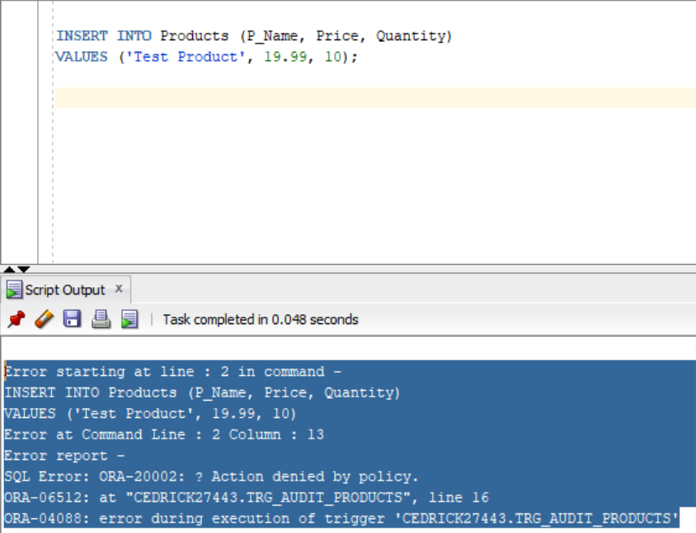
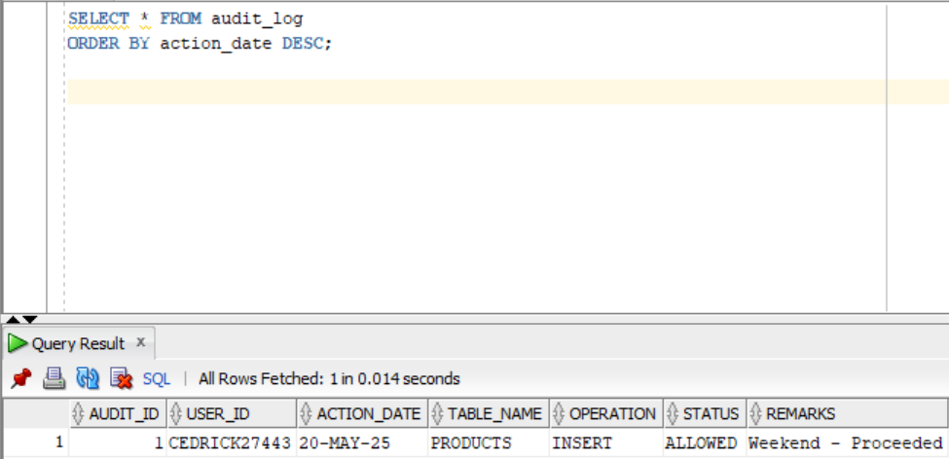
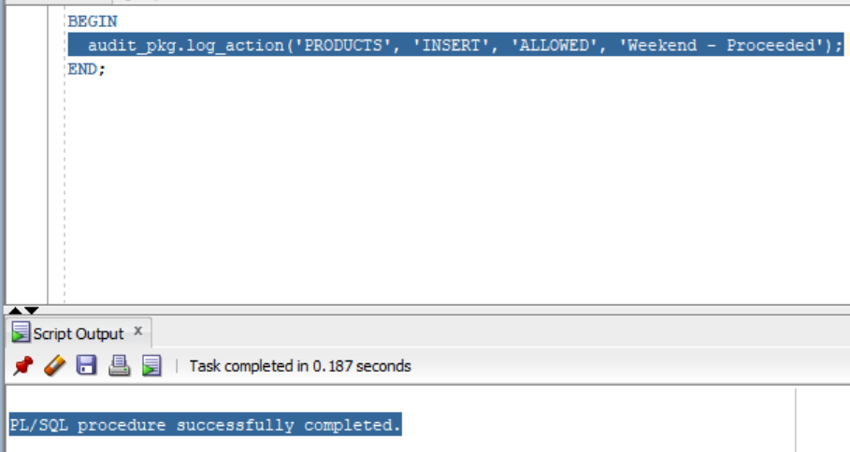
Phase VII: Advanced Database Programming & Auditing.
This screenshot shows the result of attempting to INSERT into the Products table on a restricted day (weekday or holiday). The trigger TRG_AUDIT_PRODUCTS detects the restriction and raises a custom error via RAISE_APPLICATION_ERROR, as per our capstone requirement.
Using the query SELECT * FROM audit_log ORDER BY action_date DESC, this image displays the most recent audit entry, including the user ID, table affected, operation type, and a remark ("Weekend - Proceeded"). This verifies that the auditing system logs activity exactly as designed.
This image confirms the successful manual execution of the audit_pkg.log_action procedure. This logs an "ALLOWED" action during the permitted period (e.g., weekend), simulating what a trigger would do in the background during normal operations.
20
25
08

Slide 9
Recommendations, Future work
Conclusion
References
Weekday/holiday restrictions strengthen data policies
Add role-based user controls
https://www.drawio.com/
Auditing, triggers, and analytics enhance reliability and automation
Integrate real-time notifications (SMS/email)
https://www.mermaidchart.com/
PL/SQL offers robust tools for secure data management
Expand system to include customer and order management
PLSQL_Capstone_Project_AUCA_PhaseI_VII_@2024_2025.pdf
20
25
09

Slide 10
THANK YOU
Hebrews 11:1 (NIV)
“Now faith is confidence in what we hope for and assurance about what we do not see.”
10
20
25

